Slide 1
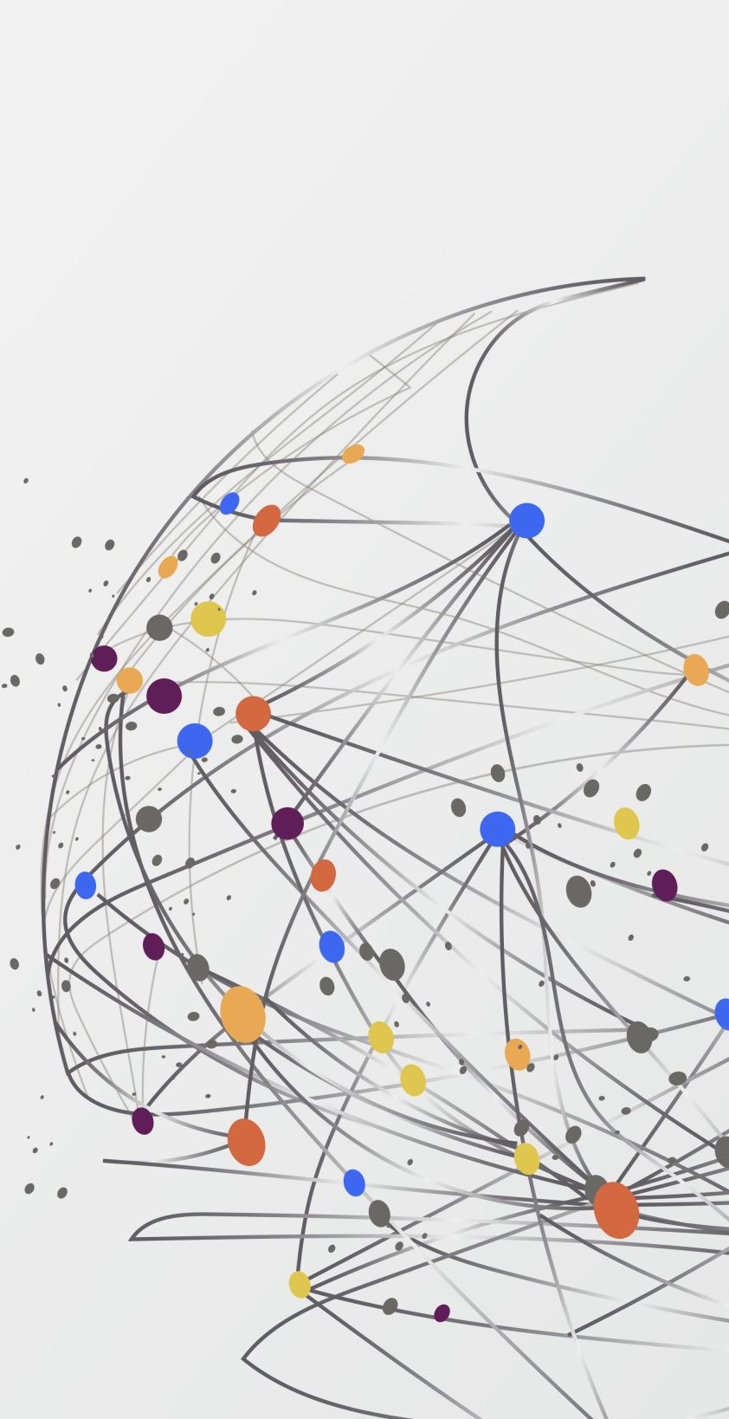
Vizualization
Project week 4 – Ironhack
Robin & tatiana

Slide 2
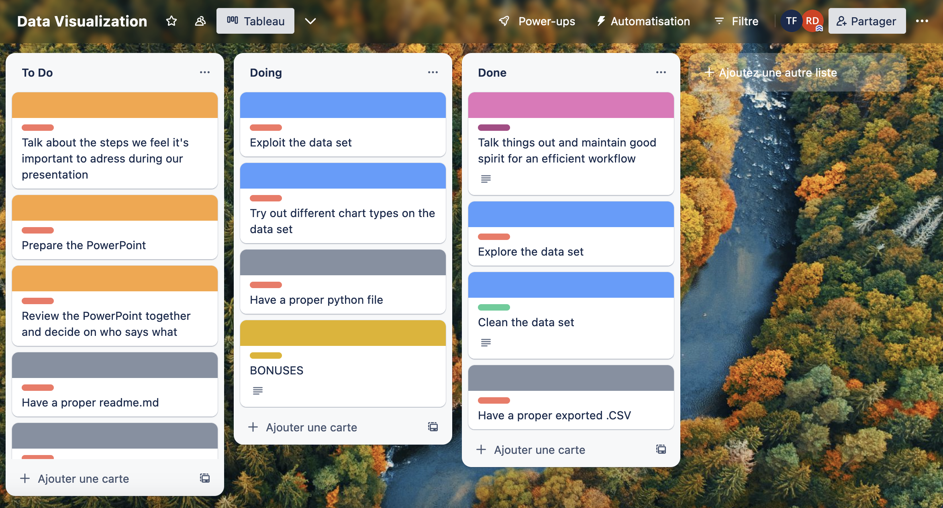
Process : Friday @ 1620 military time

Slide 3
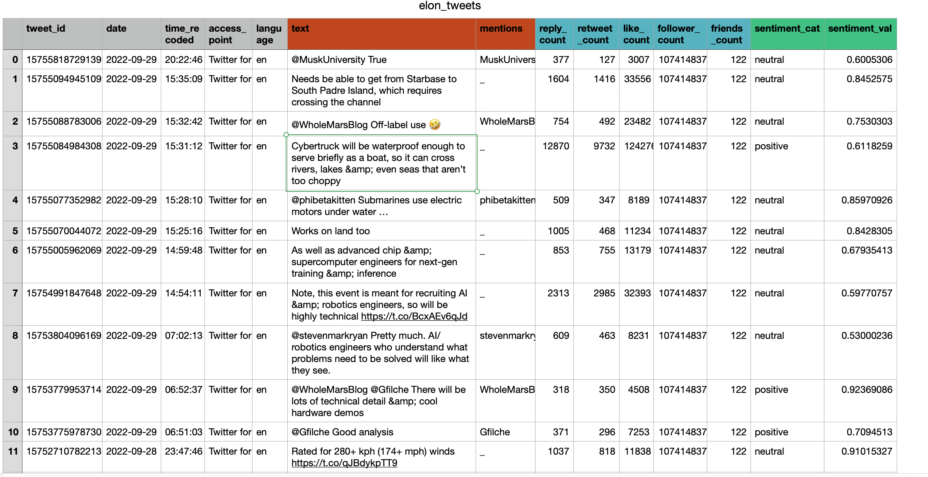
clean Dataset

Slide 4
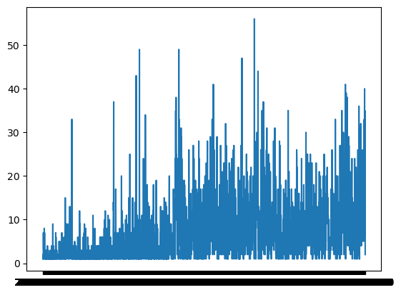
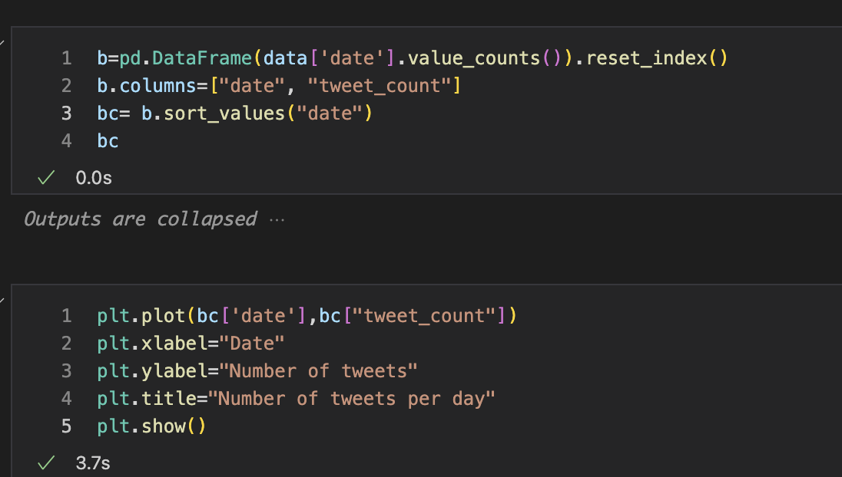
Tweet count over time

Slide 5
TWEET COUNT OVER TIME (2)
Ajouter les graphs de Robin ☺

Slide 6
TWEET COUNT OVER TIME (3)
Et le super bonus qui bouge tout seul !

Slide 7
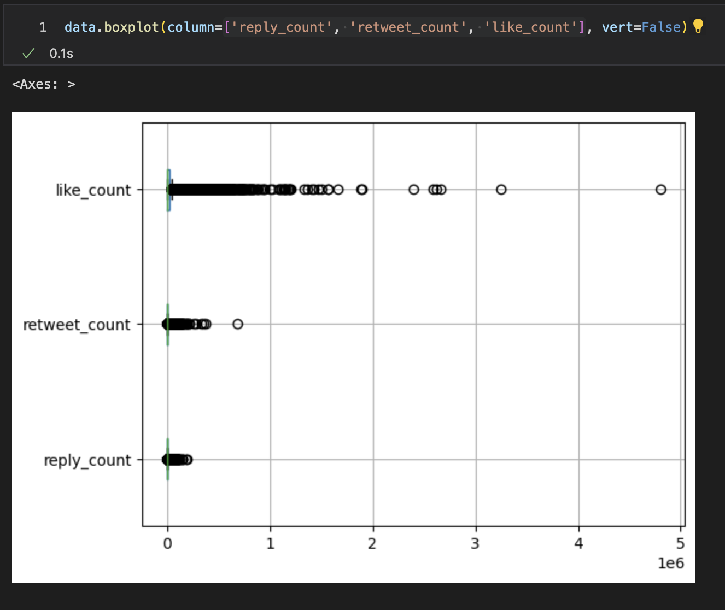
Tweet engagement rates distribution

Slide 8
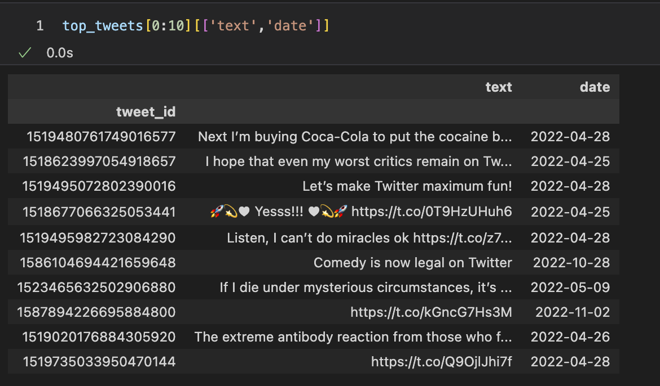
What are these top tweets that skew the data ?

Slide 9
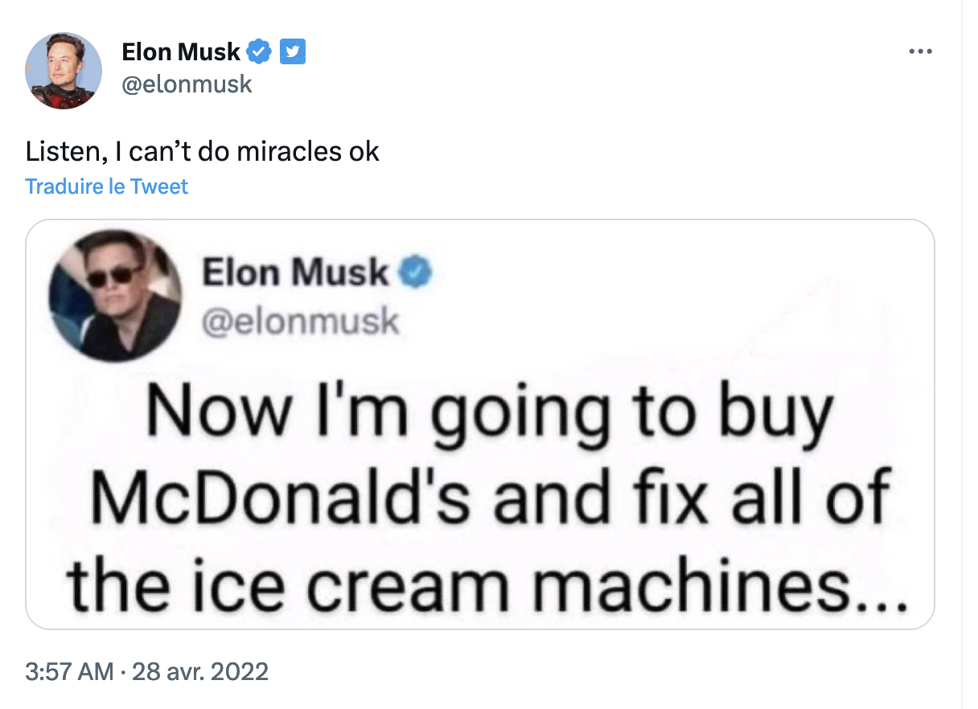
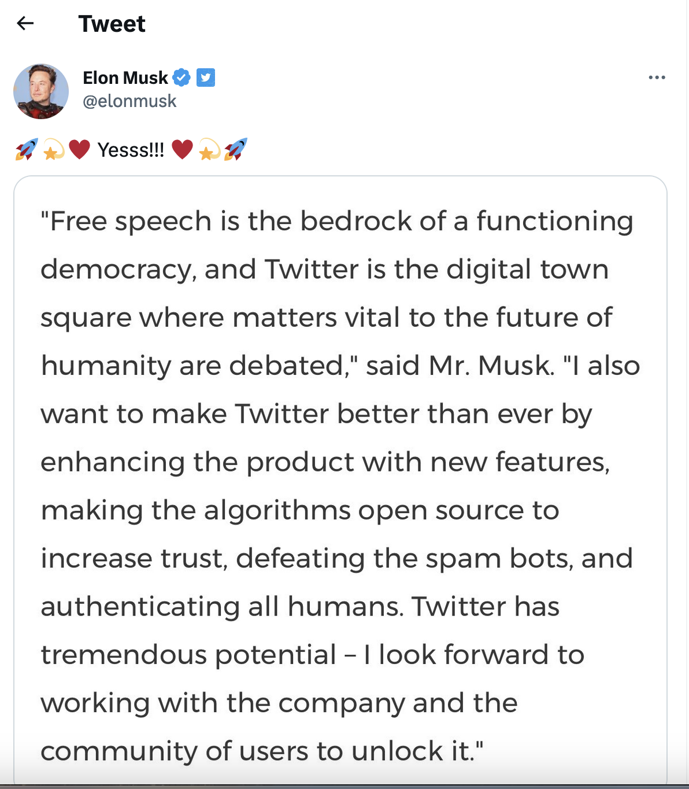
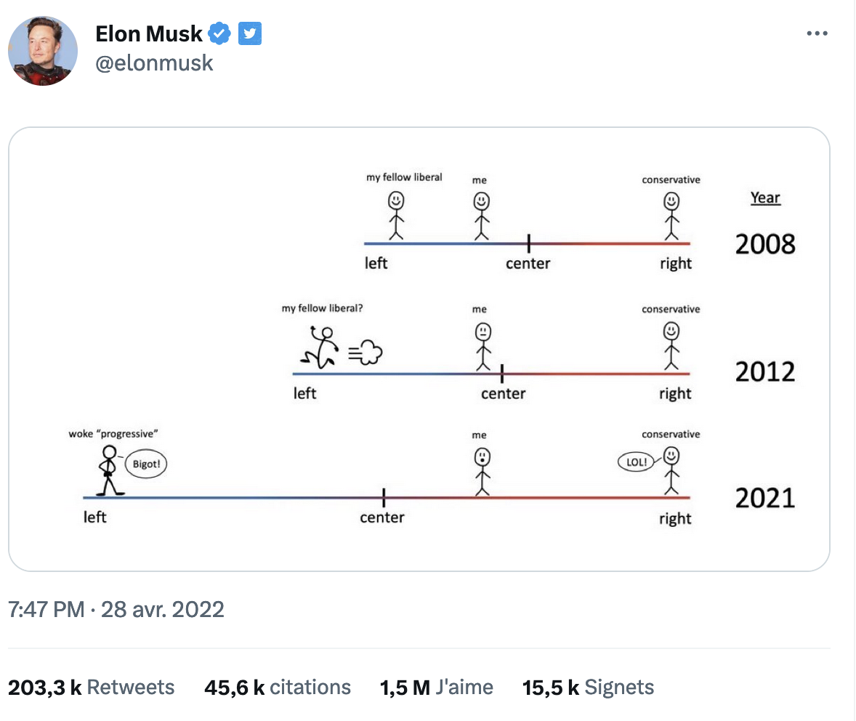
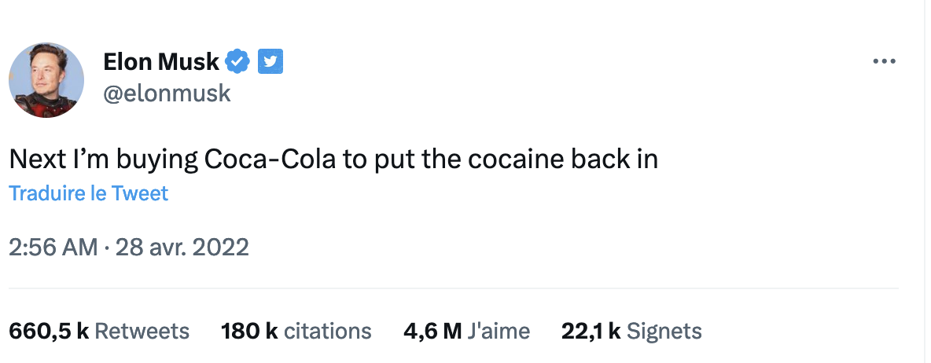
Our « flyers »
What happened
April 28,
2022 ?

Slide 10
Tweet engagement rates distribution (without outliers)
Notes:
We notice the scales against which we are measuring likes, RT and reply are not the same, but it's ok, because these measures are highly correlated.

Slide 11

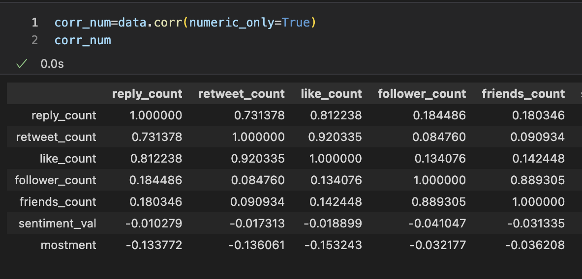
Counts of likes, RT, replies are correlated

Slide 12
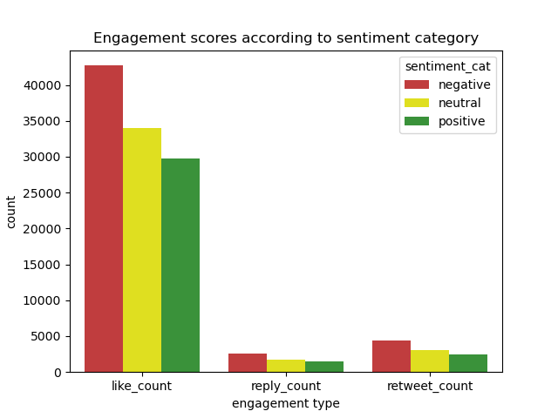
DOES TONE MATTER ?

Slide 13
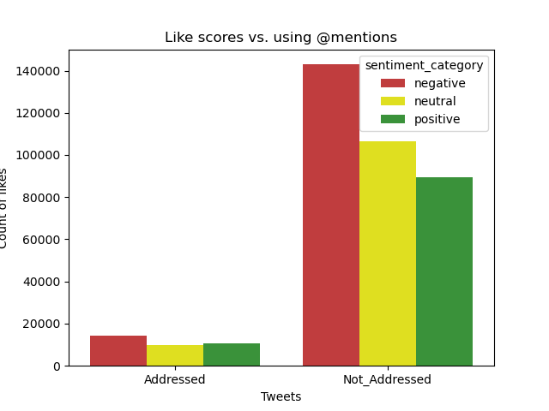
Does addressing matter ?

Slide 14
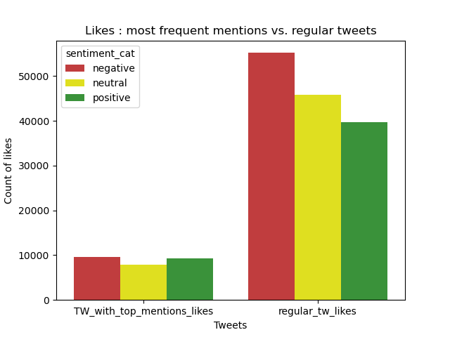
Even the ones you mention all the time ?

